Slide 1
Capstone Project On
Ted Talk Views prediction
Team name- Data Newbies
Team Members - Rohit Kumar Raj Cohort- Canberra
Ranjita Raj
Sandhyarani Patra

Slide 2
Contents-
Overview
Problem Statement
Data Pipeline
EDA on Features
Feature Engineering
Feature Selection
Models Used
Which model did I choose and why?
Challenges
Conclusion

Slide 3
OVERVIEW:
TED is devoted to spreading powerful ideas on just about any topic. These datasets contain over 4,000 TED talks including transcripts in many languages Founded in 1984 by Richard Salman as a nonprofit organization that aimed at bringing experts from the fields of Technology, Entertainment, and Design together.
TED Conferences have gone on to become the Mecca of ideas from virtually all walks of life.
As of 2015, TED and its sister TEDx chapters have published more than 2000 talks for free consumption by the masses and its speaker list boasts of the likes of Al Gore, Jimmy Wales, Shahrukh Khan, and Bill Gates.
The main objective is to build a predictive model, which could help in predicting the views of the videos uploaded on the TEDx website.

Slide 4
The dataset contains features
talk_id: Talk identification number provided by TED
title: Title of the talk
speaker_1: First speaker in TED's speaker list
all_speakers: Speakers in the talk
occupations: Occupations of the speakers
about_speakers: Blurb about each speaker
recorded_date: Date the talk was recorded
published_date: Date the talk was published to TED.com
event: Event or medium in which the talk was given
native_lang: Language the talk was given in
available_lang: All available languages (lang_code) for a talk
comments: Count of comments
duration: Duration in seconds
topics: Related tags or topics for the talk
related_talks: Related talks (key='talk_id',value='title’)
url: URL of the talk description: Description of the talk
transcript: Full transcript of the talk

Slide 5
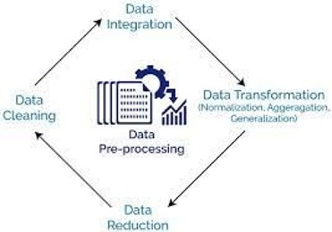
Data Pipeline
Understanding the Data
EDA/Cleaning the Data: The data was checked for duplicate values, null and missing values, and primary inspection was performed. Exploratory data analysis was performed to analyse and visualize the data.
Feature Engineering: Creating insightful features and transforming data.

Slide 6
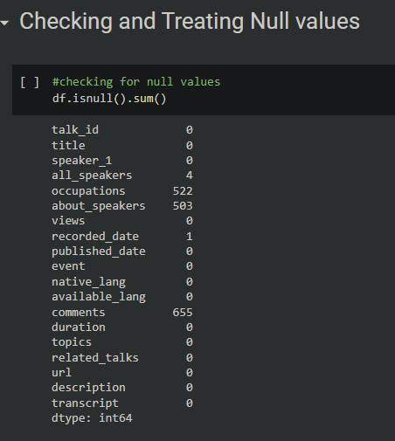
Checking for Null values
Columns having Null Values
Occupations
About_Speakers
Comments

Slide 7
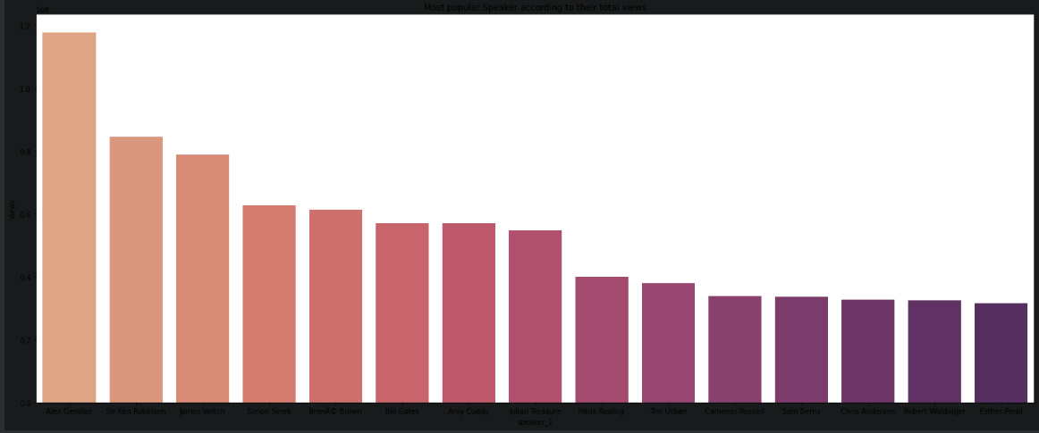
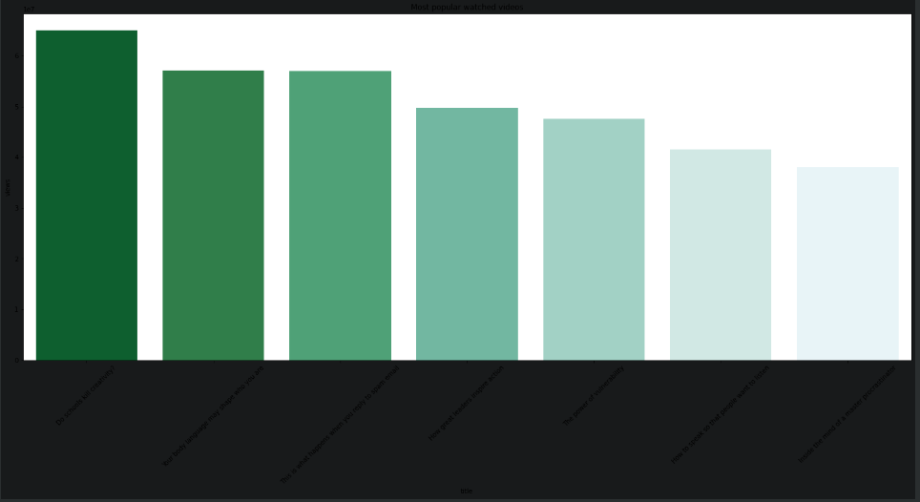
Exploratory Data Analysis
Alex gendler is the most popular Ted Speaker.
Do Schools kill creativity is the most watched video on Ted Platform.

Slide 8
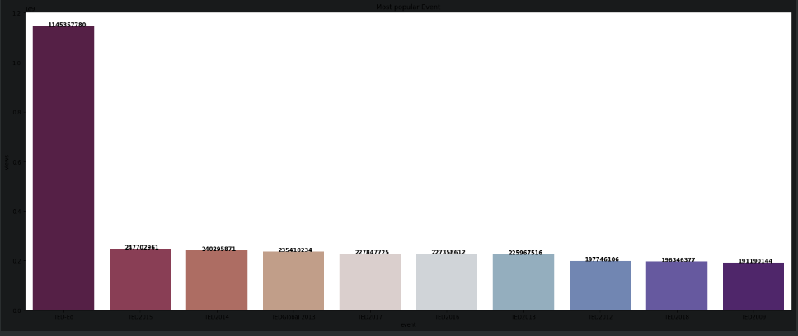
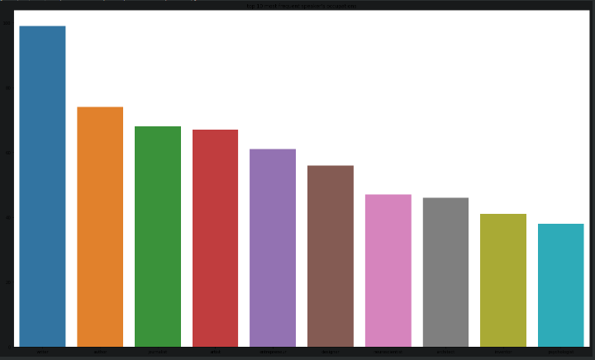
Exploratory Data Analysis
TED-Ed is Most popular event on TED.
Occupation of most frequent speaker is Writer followed by Author.

Slide 9
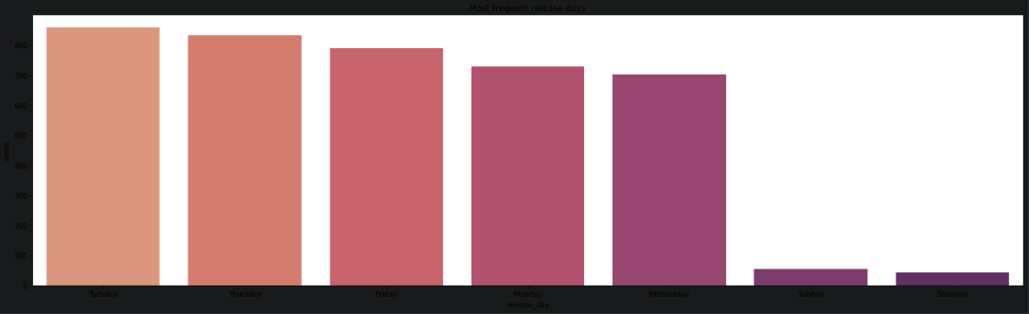
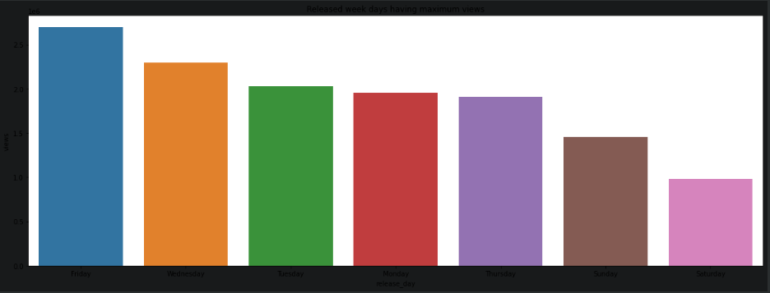
Exploratory Data Analysis
Tuesday is the most frequent release day of the week followed by Thursday.
Friday is the best release day of the week with respect to average views.

Slide 10
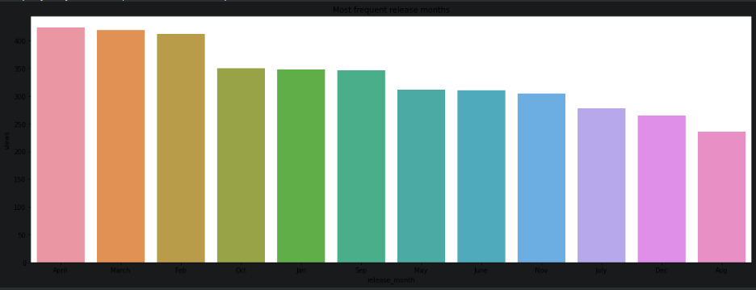
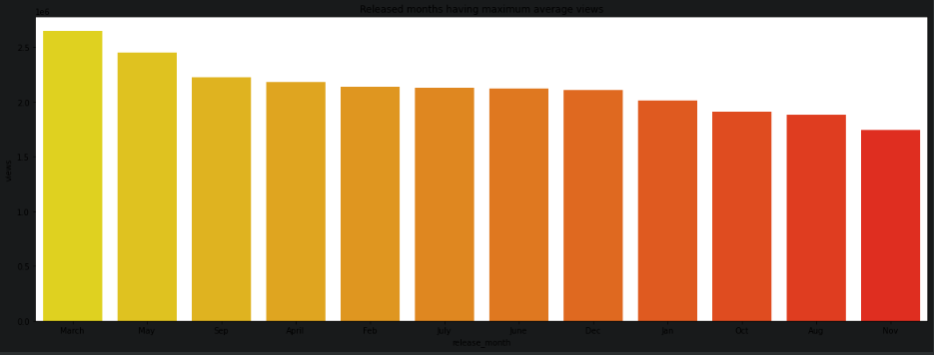
Exploratory Data Analysis
April is the most frequent release month of the year.
The month March has maximum average views followed by May.

Slide 11
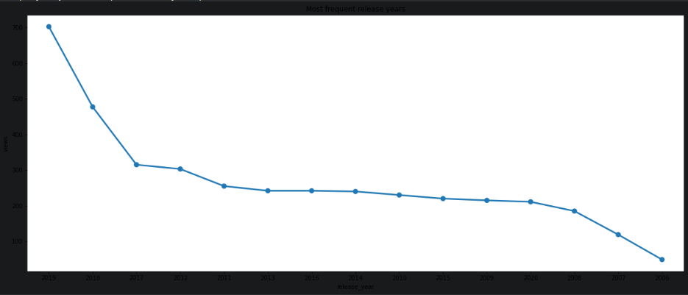
Exploratory Data Analysis
Most Videos are published in the year 2019 followed by 2018 and 2017.
Least number in the year 2006.

Slide 12
Feature Engineering
Feature engineering is the process of using domain knowledge to extract features from raw data. The motivation is to use these extra features to improve the quality of results from a machine learning process, compared with supplying only the raw data to the machine learning process.
Wetried adding and removing some features in this section in order to make a perfect data matrix we can pass to a machine learning model. We will try to interpret categorical features as numeric to be passed to the ML models.
Speaker_avg_views
Event_wise_avg_views
Topic_wise_avg_views
Num_of_languages
Published_day

Slide 13
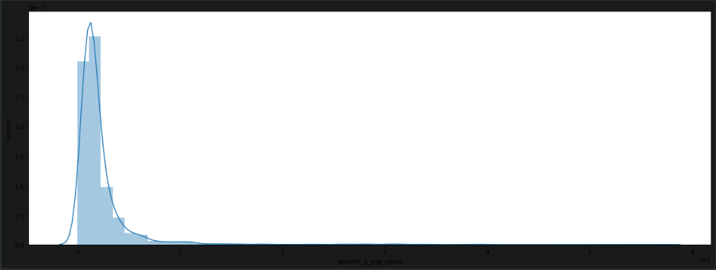
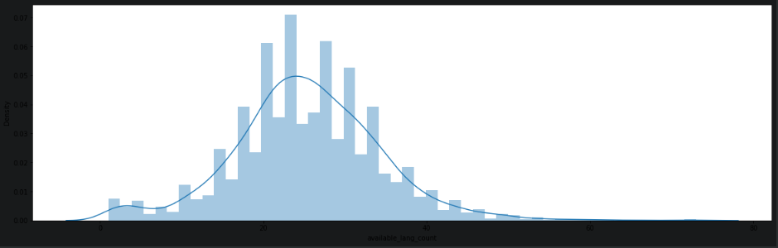
Feature Engineering
Feature Engineering on Speaker–1 Column and it is rightly Skewed.
As Skewness is less than 1 , it is normal distribution

Slide 14
Machine Learning Model Used
Linear Regressor
Random forest Regressor
XGB Regressor
Hyper - Parameter tuning
Random Search CV
Metrics Used
R2
RMSE
MAE

Slide 15
Linear Regressor
R2 Score for Train – 0.8177
R2 Score for Test – 0.8520
MAE Score for Train – 271426.40
MAE Score for Test – 243353.57
RMSE Score for Train – 470463.24
RMSE Score for Test – 424644.19

Slide 16
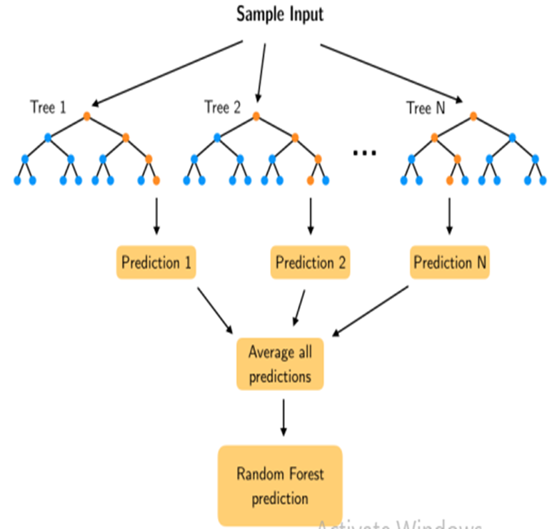
Random Forest Regressor
R2 Score for Train – 0.8244
R2 Score for Test – 0.8438
MAE Score for Train – 185073.04
MAE Score for Test – 168953.27
RMSE Score for Train – 461787.90
RMSE Score for Test – 436254.71

Slide 17
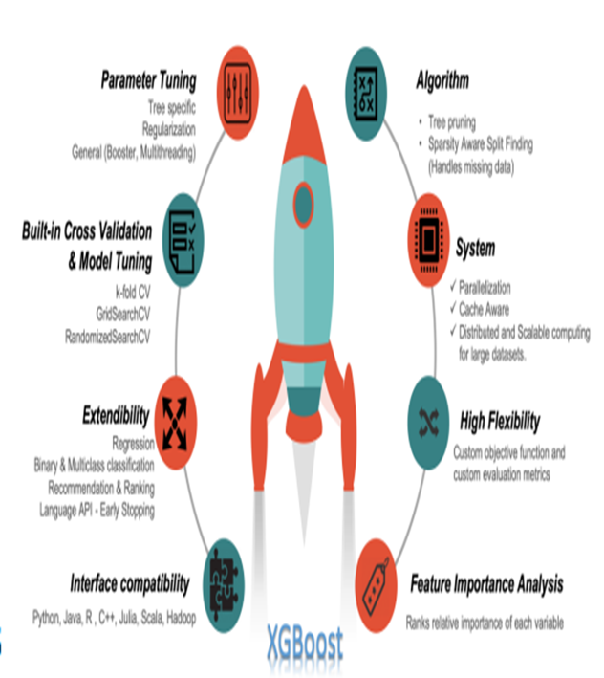
XGB Regressor
R2 Score for Train – 0.9592
R2 Score for Test – 0.8649
MAE Score for Train – 119053.88
MAE Score for Test – 207756.24
RMSE Score for Train – 222622.28
RMSE Score for Test – 405676.23

Slide 18
Which Model Did we Choose And Why?
We choose MAE and not RMSE as the deciding factor of our model selection because of the following reasons:
As we know, RMSE is more influenced by outliers MAE doesn't increase with outliers.
MAE is linear and RMSE is quadratically increasing.
So, We choosed MAE as a deciding factor for our model.
On the basis of MAE, The best performing regression model is Random Forest Regressor.

Slide 19
CONCLUSION
Through our Analysis, we have discovered key insights about what factors inﬂuence the Views gained by a video .
Topics like Technology , Science , Education , Biology attract the attention of viewers more than other topics .
Most TED Speaker’s Occupation is Writer, followed by Author.
The Hyperparameter Tuning prevented overfitting and decreased errors by regularzing the models.
The Random Forest Regressor performed the best in terms of Mean Absolute Error,As we choose MAE as our deciding factor because MAE is not affected by the Outliers.

Slide 20
Challenges and Future Scope
Dataset have lots of textual and categorical data having high cardinality .
  So the conversion to meaningful numerical data was a challenge.
Feature Engineering and Feature Extraction
  can always be improved in creative ways
  We can explore more advanced feature encoding

Slide 21
Thank You

